Slide 1

Radiation Protection
RT4220 – Lecture #9
Kedree Proffitt
WSU
10/09/2025

Slide 2
Background Radiation Context
For the average individual ~50% of their annual dose is medical, and ~50% natural
For the Amish and poor its probably ~100%
Average annual dose for an American is quoted to be about 6.4 mSv (3.2 mSv natural, 3.2 mSv man-made)
Plurality of man-made is CTs (medically necessary and fruitful!)
Majority of Natural is Radon/Thoron (probably not as bad as we think)
Every hour of flying at cruising height adds 0.004 mSv
Flight from Detroit to Shanghai is then ~ 2% of your annual dose (0.06 mSv)

Slide 3
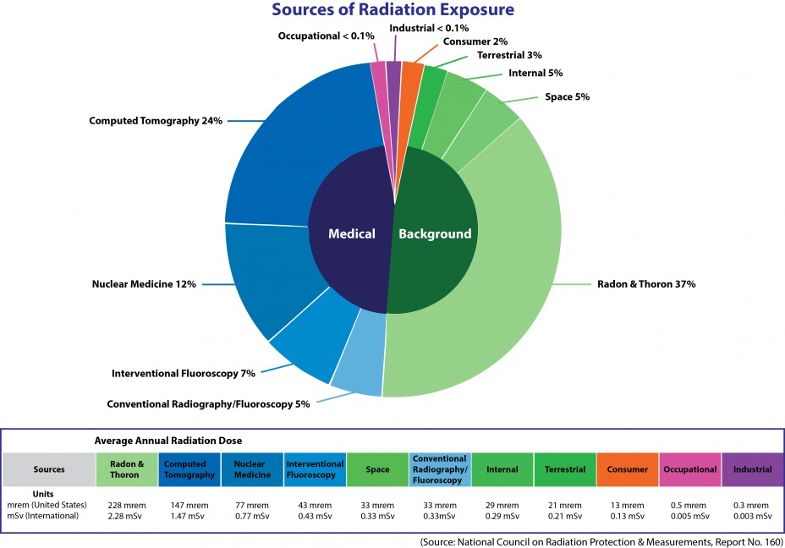

Slide 4
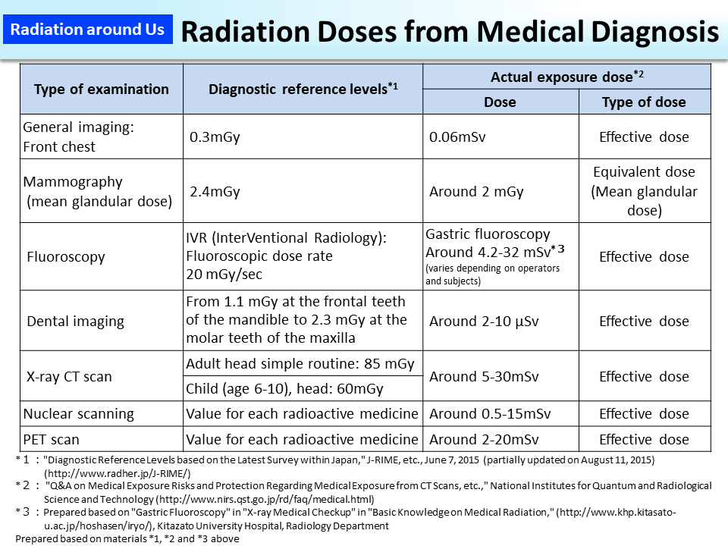

Slide 5
Radiation Safety: Quantities and Units
Cumulative Activity
Effective Half-life
Exposure (X)
Absorbed Dose (D)
Dose Equivalent (H)
Relative Biological Effectiveness

Slide 6
Cumulative Activity
Cumulated Activity (Ã)
Total amount of radioactivity absorbed
The SI unit for cumulated activity is Bq*sec or just “disintegrations” (Ci*s is also acceptable)
If the source is left in place permanently then:
Cumulated activity (Ã) ≈ A₀ *τ
A₀ = Initial activity
τ= Mean life
Ã= A₀ *t_{1/2}*1.44

Slide 7
Cumulative Activity: Effective Mean Life
If the source is left in place (permanently) and the body is biologically riding itself of the radionuclide at the same time then:
Cumulated activity (Ã) ≈ A₀ *τ_{eff}
A₀ = Initial activity
τ_{eff} = Effective Mean Life
τ_{eff} = 1.44*t_{1/2 eff}
Ã = A₀*t_{1/2eff}*1.44

Slide 8
Effective Half-life
The effective half-life (t_{1/2})_{eff} is a combination of physical and biological half-life
(t_{1/2})_{phy} = Physical Half-life: time required to decay to one half of radioactive nuclide
(t_{1/2})_{bio} = Biological Half-life: time required for the body to clear one half of the drug from the body/system
The effective half-life determines the what radioactivity will be observed while the body is ridding itself of the radionuclide over time by urine, feces, sweat, etc

Slide 9
Exposure
It is the amount of ionization produced in air
Only defined for air
Unit of Roentgen or Coulomb / kg
1 R = 2.58 x 10⁻⁴ C / kg

Slide 10
Absorbed Dose
Absorbed dose is the energy absorbed per unit mass
Units: rad or Gray (1 Gy = 1 J/kg )
100 rad = 1 Gy = 100 cGy
1 rad = 1 cGy

Slide 11
Dose Equivalent
Dose equivalent (H)
Product of absorbed dose (D) and radiation weighting factor (W_{R}), formerly the quality factor (QF)
H = D x W_{R}
W_{R} accounts for the type of radiation deposited (neutrons, photons, etc)
Unit: Sievert (Sv) or rem
100 rem = 1 Sv
1 rem = 10 mSv

Slide 12
Dose Equivalent
Absorbed Dose Equiv. (H) =
Absorbed dose (D) x Weighting Factor (W_{R})
Sievert = Gray * W_{R} (SI units)
rem = rad * W_{R}
(100 rem = 1 Sievert)
( 1 rem = 0.01 Sievert)
(100 rad = 1 Gray)
( 1 rad = 0.01 Gray)

Slide 13
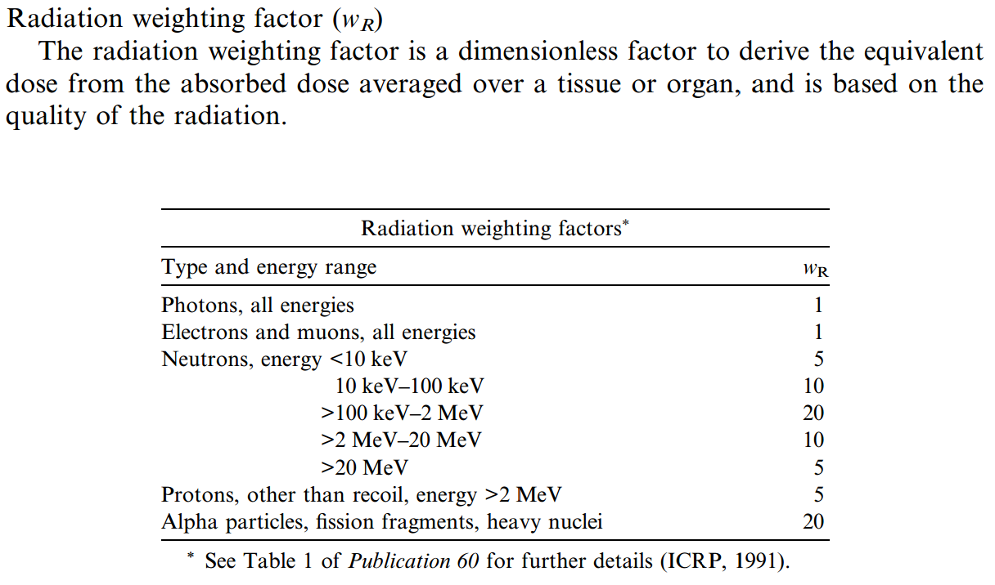
Radiation Weighting Factor

Slide 14
Principles of Radiation Safety
Reduce dose as much as is reasonably possible (ALARA)
Dose reduction via three methods:
Distance (Inverse Square Law)
Time (Duh)
Shielding (idk what to put here)
Keep in mind what we are shielding from!

Slide 15
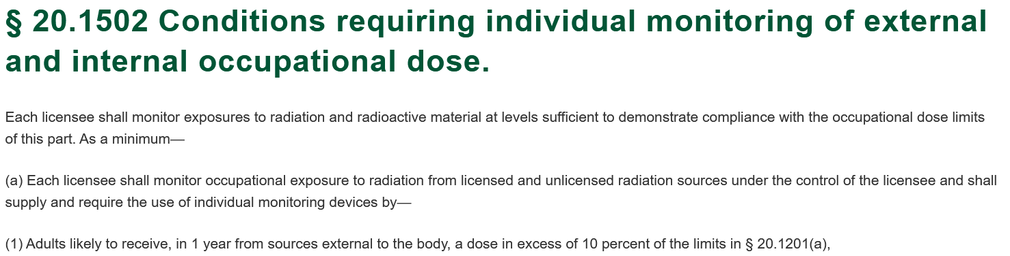
Exposure Limits
NRC and NCRP define Maximum Permissible Doses for civilians and rad. workers alike (you!)
Only include exposure from work activities! (No background rad.)
Any personnel expected to receive >10% of the limit must use a Radiation Monitoring Device.

Slide 16
Maximum Permissible Dose Limits
Occupational Exposure | Whole Body (mSv) | Extremities (mSv) | Lens of the Eye (msV) | Embryo-Fetus (mSv)
Monthly |  |  |  | 0.5
Annual | 50 | 500 | 150 | 5
Cumulative | 10 x Age
Civilian Exposure | Infrequent (mSv) | Frequent (mSv)
Annual | 1 | 5
* The rule for minors is always 10% of the above

Slide 17
Pregnancy Declaration
Pregnant workers should declare pregnancy ASAP in writing
The rules only apply to you after that declaration!
Most workers find that their job is barely affected, they become more cognizant of unnecessary dose
Multiple methods of staying aware:
Begin consultation with RSO on how to reduce dose
Constant use of an “always-on” pocket dosimeter with an alarm

Slide 18
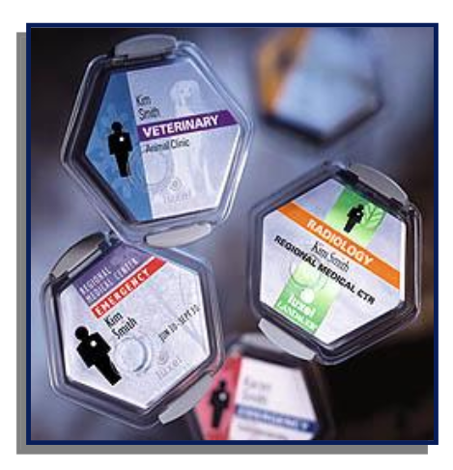
Personal Dosimeters
No reason to not wear them!
Front of the badge faces away, should be placed below the neck, but above the waist
If they are damaged or lost, contact your RSO, they don’t bite!

Slide 19
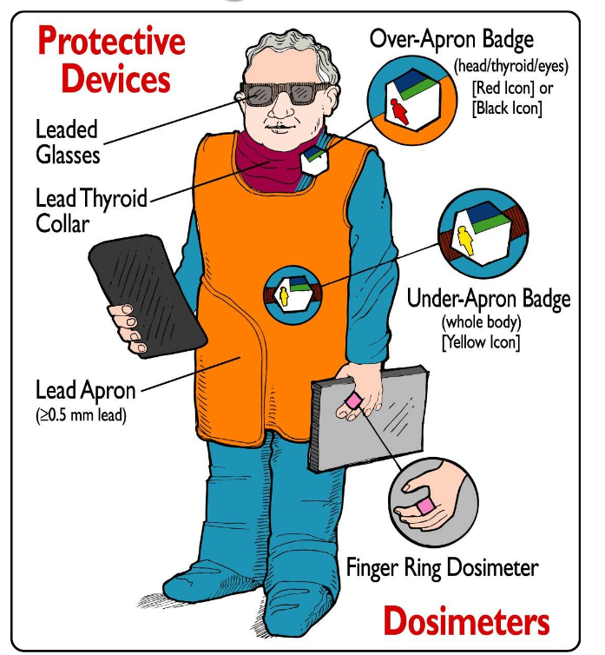
Keep personal dosimeters away from heat, sources of radiation.
Do not take them home!
Ring badges worn on hand during radionuclide assay

Slide 20
ALARA
AS LOW AS REASONABLY ACHEIVABLE
This concept is ever-present, every radiation worker in every step of the process keeps this principle in mind
Keep dose low, keep people safe, keep expectations reasonable so that people actually follow the rules!
Vast majority of rad. workers’ dose is <10% of the limit, we do a great job!

Slide 21
Dose Reduction Techniques
Minimize Time
Slow is steady, steady is fast. Practice and become confident, but not complacent
Do not dilly-dally!
Maximize Distance
Probably the easiest one to do, especially for radiopharm procedures, easiest to forget too!
Stay as far away as is reasonable, without freaking the patient out
Maximize Shielding
Often overlooked, and personal shielding can be strenuous

Slide 22
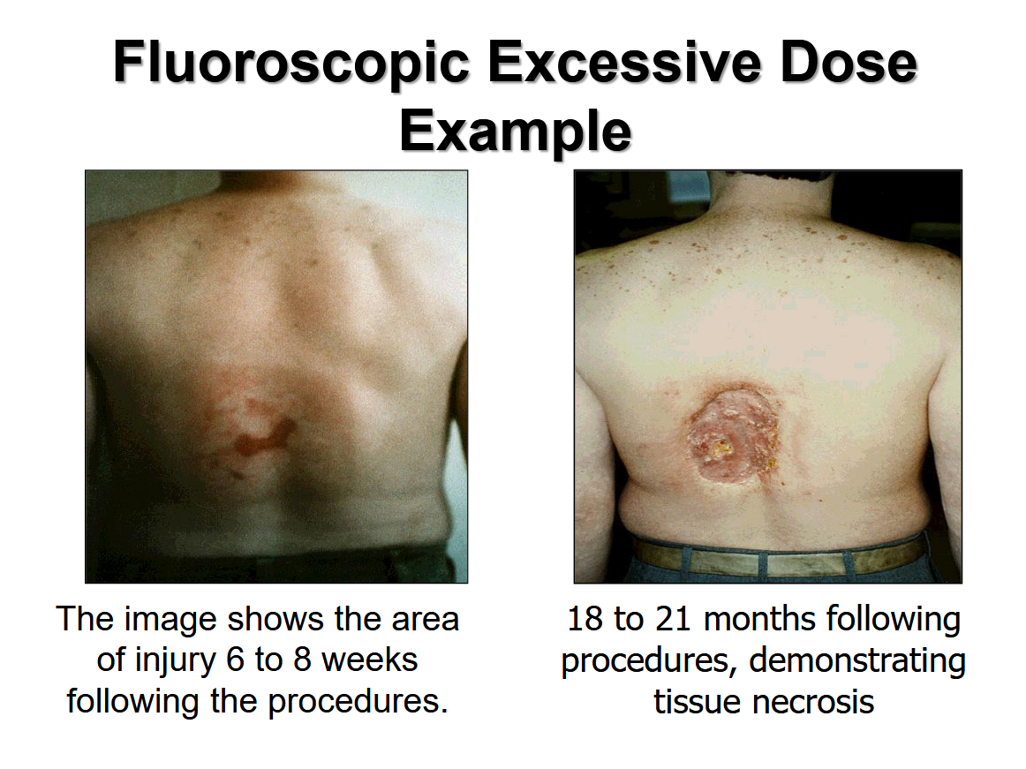

Slide 23
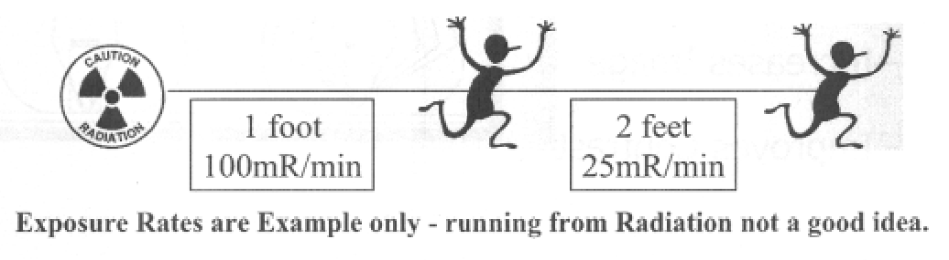
Importance of Distance as Radiation Protection
Extremely effective and more importantly cheap!
Just one step back can “reduce exposure by a factor of 4”

Slide 24
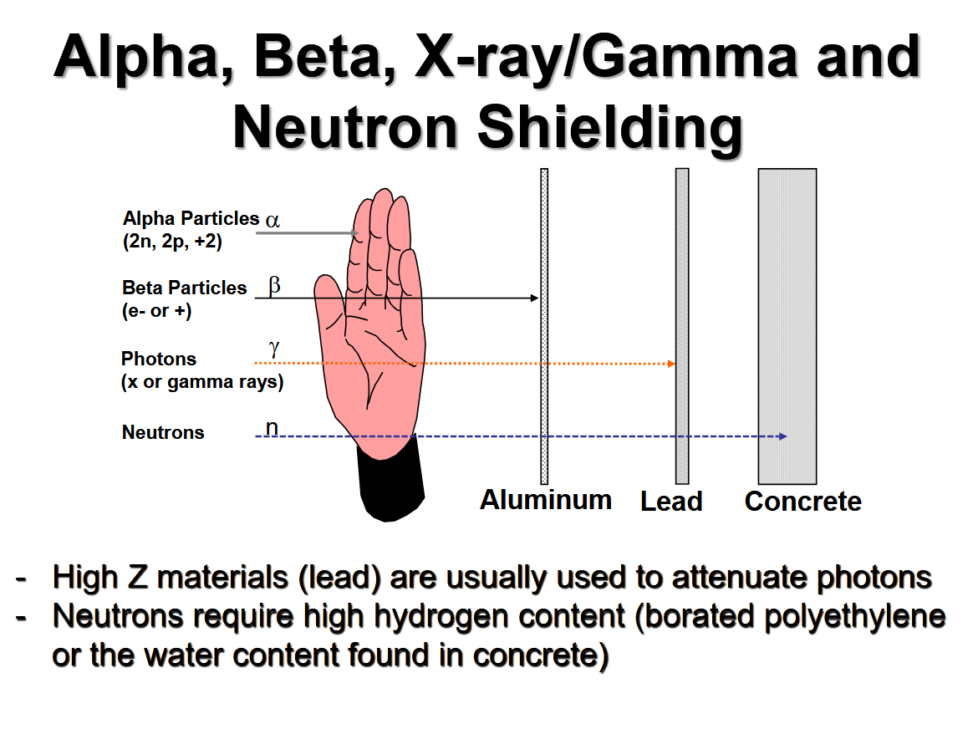

Slide 25
Shielding as a Protective Method
Types of personal shields:
Lead Aprons
Thyroid Shields
Leaded Eye Wear
Leaded Gloves
Leaded materials have a “lead equivalent” (0.5 mm is standard)
Lead is awesome for betas and low energy (scatter/diagnostic) photons
Lead is nearly useless for high-energy photons:
100 keV Transmission = 4.3%
511 keV Transmission = 91%

Slide 26
When Lead Aprons are Less Useful
Medium to high energy photons are barely protected against
Tc-99m
I-131
Positron Emitters like F-18
Those aprons are heavy! It really takes a toll on your body

Slide 27
X-Ray Shielding Guidelines (NCRP)
NCRP Report No. 147: Structural Shielding Design for Medical X-Ray Imaging Facilities
NCRP Report No. 151: Structural Shielding Design and Evaluation for Megavoltage X and Gamma ray Radiotherapy Facilities
Physicists use the above to calculate how much shielding we need to keep everyone within spec. (limits and ALARA guidelines too!)

Slide 28
X-Ray Shielding
We protect against the following three sources of radiation (descending importance):
Primary Radiation (the beam)
Scattered Radiation (mostly the patient)
Leakage (from the tube and housing)
Shielding is done in context with surrounding rooms, even the outdoors!
Toilets require less shielding than offices
Is there a car park nearby?
Do not put your linac above the maternity ward…

Slide 29
Primary Beam Shielding
For radiography AND Linacs we need to know the following:
Workload (W): Average use per week in mA minutes for X-Ray
Average beam-on time per week, accounting for kVp and mAs
Use Factor (U): Fraction of the time that the beam is pointed at this barrier
Occupancy Factor (T): Fraction of the time where people are in the area to be protected when the beam is on
Maximum Permissible Exposure (P): 10% of the regulation limits for ALARA in mSv/wk
Occupational: 0.1 mSv/wk (50 mSv/yr * 10% = 5 mSv/yr * 1 yr/50 wk = 0.1 mSv/wk)
General Public: 0.02 mSv/wk (1 mSv/yr * 1 yr/50 wk = 0.02 mSv/wk)

Slide 30
Controlled Area Classifaction
Controlled Area:
Area in which exposure of persons to radiation is under the supervision of the RSO (control of access, occupancy, and working conditions)
Used for Occupational Limits
Uncontrolled Area:
Areas not directly related to the use of radioactive sources (no control of access to area; general public and other department personnel allowed)
Use the “Grandma Test”
Used for General Public Limits

Slide 31
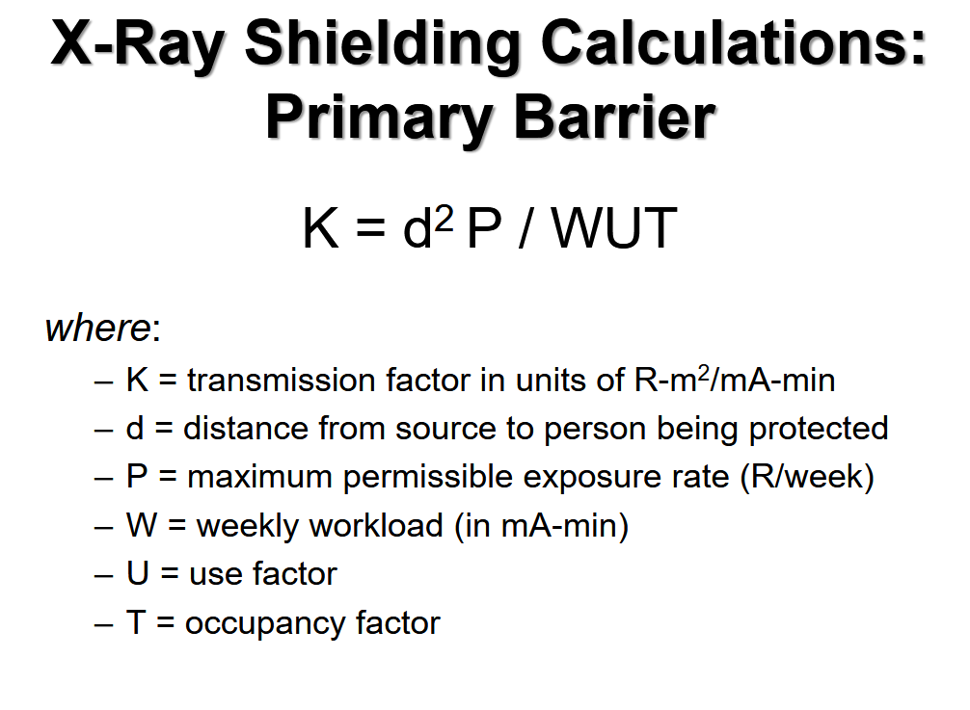

Slide 32
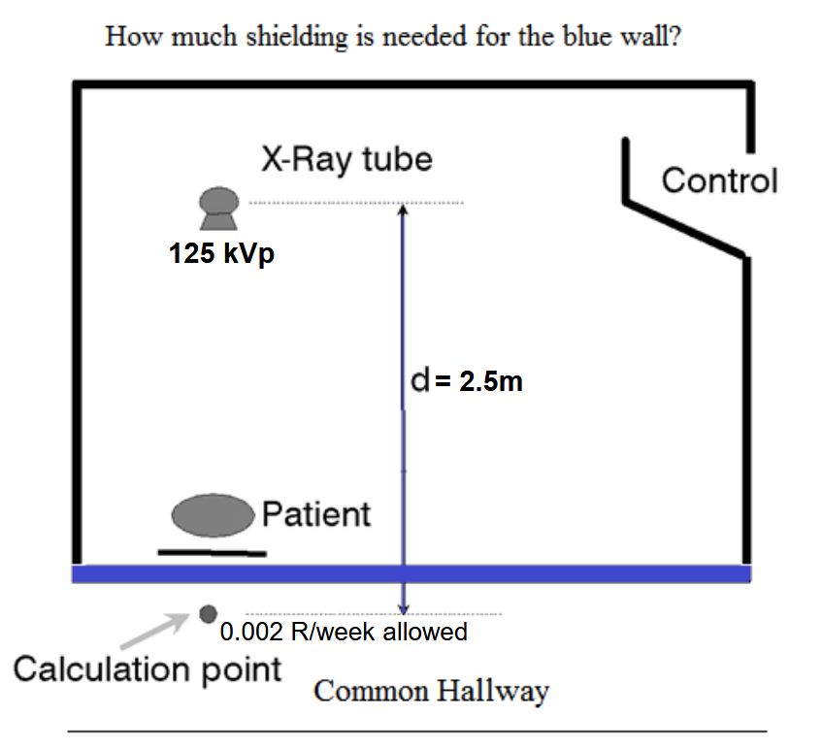

Slide 33
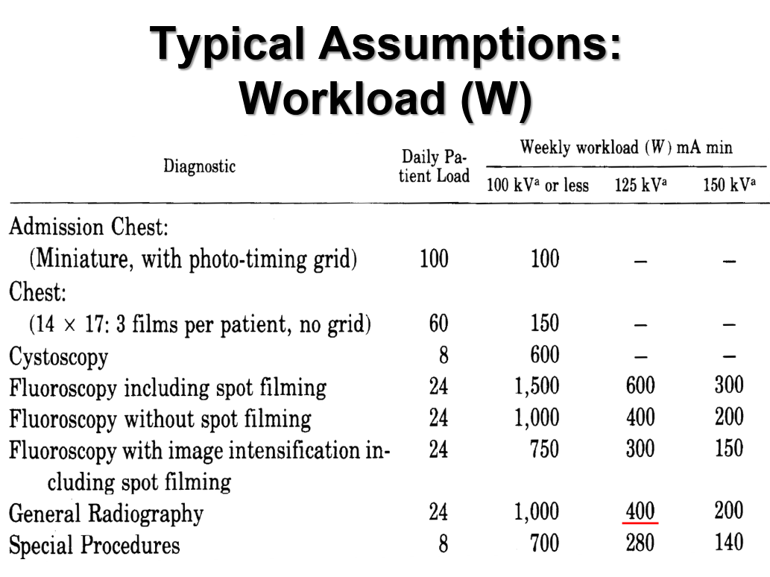

Slide 34
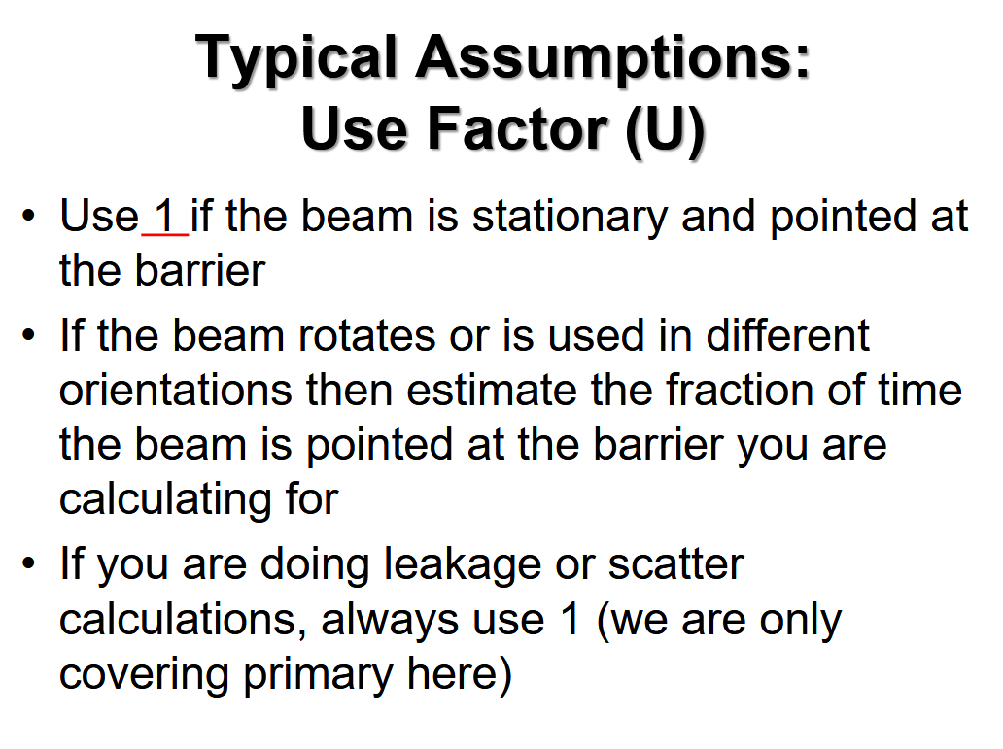

Slide 35
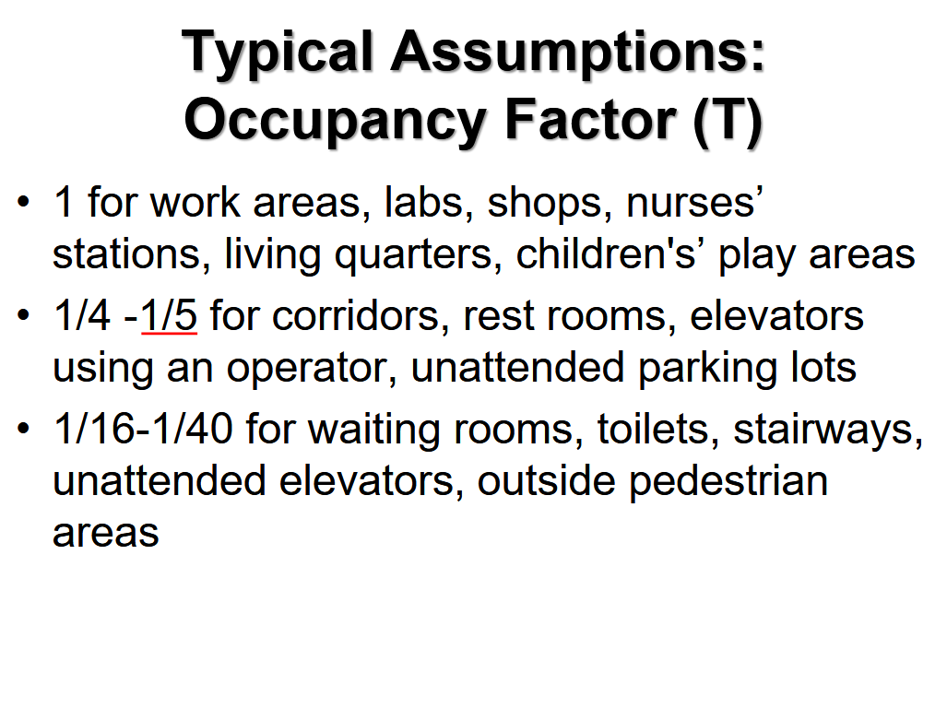

Slide 36
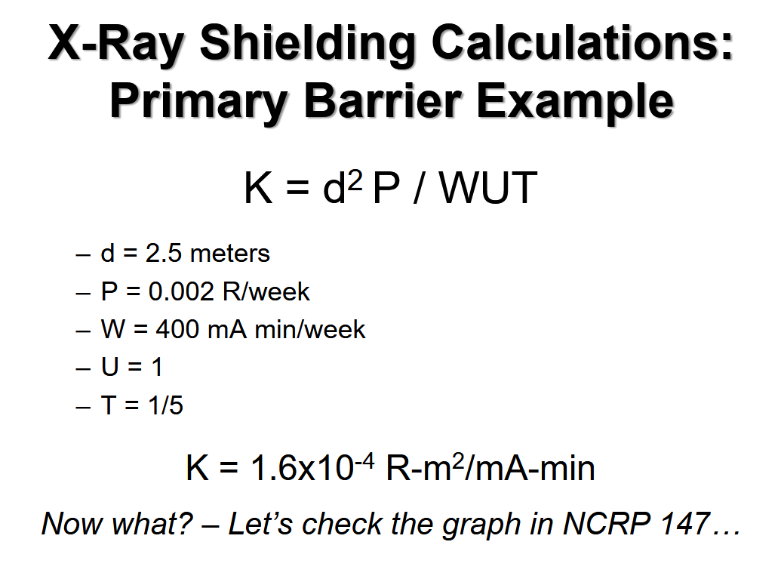

Slide 37
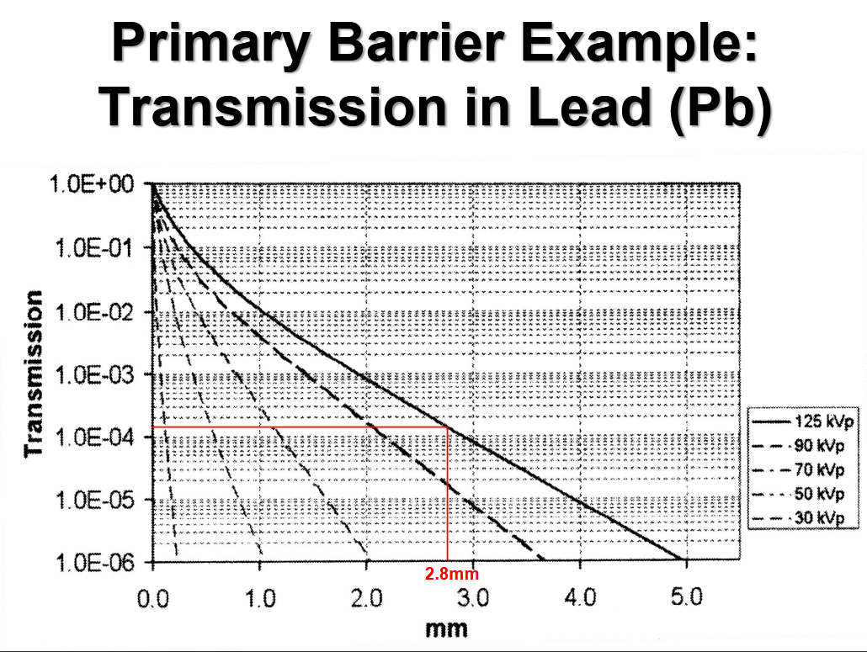

Slide 38
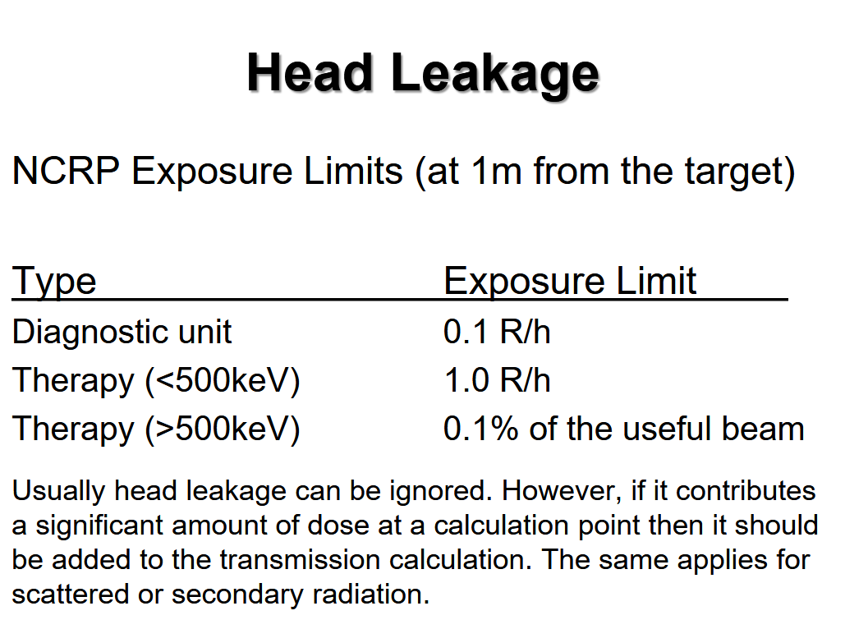

Slide 39
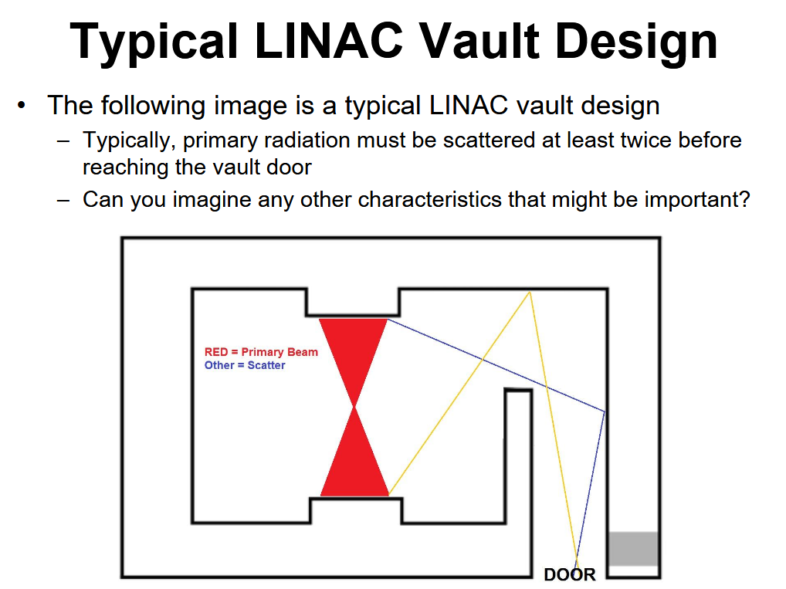

Slide 40
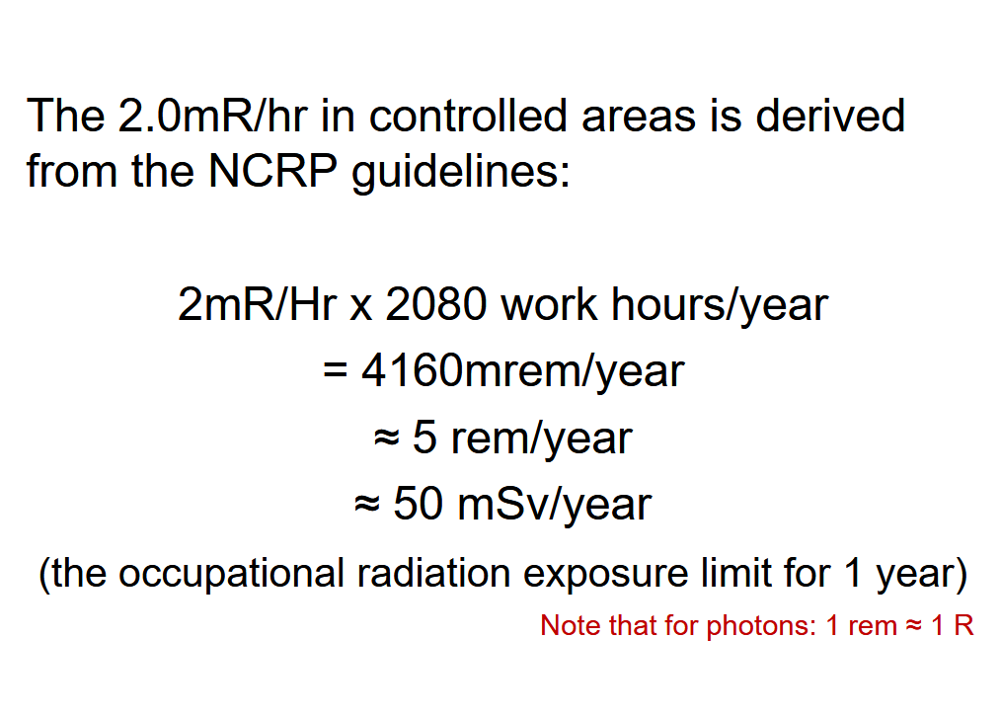

Slide 41
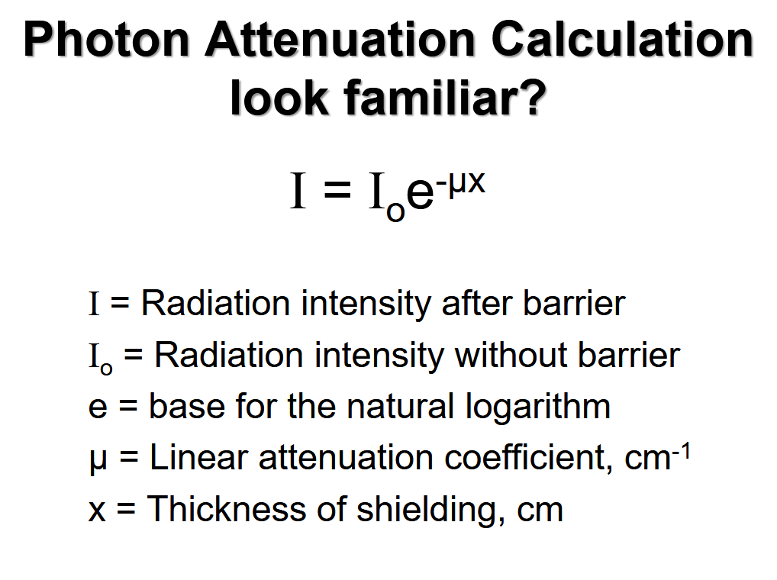

Slide 42
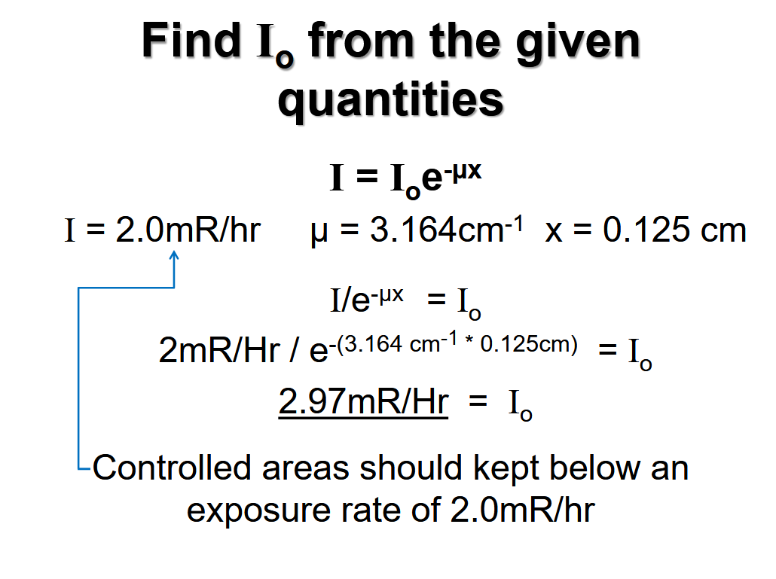

Slide 43
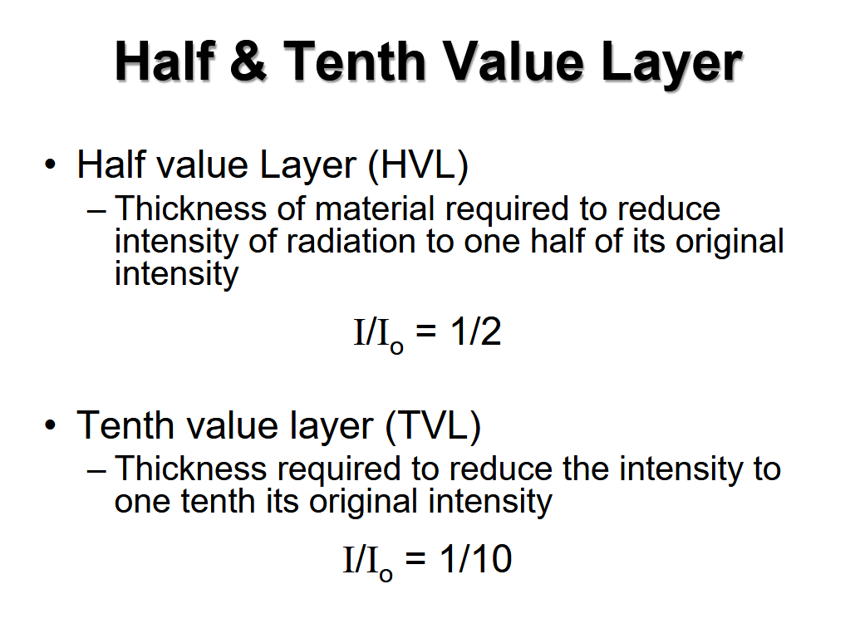

Slide 44
Security of Sources
Critical homeland security mandate
Remember this radioactivity can be used as a weapon in the wrong hands
Never leave radioactive materials unattended
Doors must be locked when sources are not under the staff control
don’t leave the key in the lock
do not give out combinations
Any unauthorized individual must be escorted from controlled areas

Slide 45
Written Directive
Written Directive: an authorized user's written order for the administration of byproduct material or radiation from byproduct material to a specific patient
Patient Identification verified
Must be issued prior to ordering dose from pharmacy
quantities greater than 30 μCi of either I-125 or I-131
any therapeutic administration of a radipharmaceutical, other than I-125 or I-131

Slide 46
Radionuclide Therapy Instruction
Provide radiation safety instruction for all personnel caring for the patient receiving Tx:
Patient or human research subject control
Visitor control
Contamination control
Waste control
Notification of the RSO in case of the patient's death or medical emergency

Slide 47
Radionuclide Safety Precautions
Provide a private room with a private sanitary facility
Post the patient's door with a "Radioactive Materials" sign
Note on the door or in the patient's chart where and how long visitors may stay in the patient's room

Slide 48
Breast-feeding Instructions
If the dose to a breast-feeding infant or child could exceed 1 mSv assuming there were no interruption of breastfeeding, provide instructions
Guidance on the interruption or discontinuation of breast-feeding
Information on the consequences of failure to follow the guidance.

Slide 49
Prevention of Unintentional
Fetal Exposure
Good History (includes asking direct question “Are you pregnant?”)
Common-sense Assessment of Risk of Pregnancy (age, prior surgery, contraception)
Pregnancy test - Beta HCG
Report to NRC any fetal exposure over 5 Rem

Slide 50
10CFR35 Patient Release Rules
A patient may be released from licensee control when the highest dose to a member of the public due to exposure to the released patient is less than 5 mSv
A patient must be given written radiation safety instructions describing methods to reduce the radiation exposure to others when the dose to another individual may exceed 1 mSv

Slide 51
Release of Individuals Containing
Radiopharmaceuticals
Maintain a record of the dose calculation for authorizing the release of an individual
Using the “retained” activity rather than the activity administered,
Using an occupancy factor less than 0.25 at 1 meter (must instruct patient & care givers),
Using effective half-life, and
May consider the shielding done in tissues

